Slide 1

Next update should focus on social integration
  Open community to increase the number of responses (Facebook, Twitter)
  Utility diminishes when nobody responds, so we’ll bridge this gap by providing some initial responses through 3rd party data API pulls
  Recommendations:
    1) Related questions from Kuipp database sorted by keywords and location (cell module is marked with a “Kuipp recommended” label
    2) Yelp & Foursquare answers: Additional way to provide answers will be to pull in recommendations or tips (tips are from Foursquare) to the users answer (cell module is marked with the company logo (in the user profile picture area)
  Kuipp Sharing
    Integrate ability to share Question, Answer as well as anyone else’s Q&A trend to Facebook & Twitter
Party / Groups
  On Hold – additional thought needs to be put into this

Slide 2

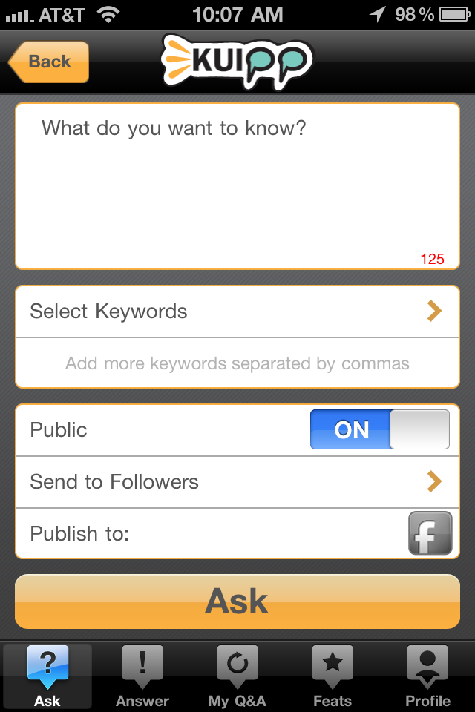



Addition of “Search On” feature where if selected, it will pull information from Yelp/Foursquare database
However, the user must specify additional keywords that will be used to pull from Yelp/Foursquare
What do you know? → Because we are allowing the new search on function, need to make sure people will as a question; implement checks to makes sure user asks a question (1. ends with a question, 2. more than 4 words long)
Publish to: Addition of Twitter along with Facebook
Search On

Slide 3

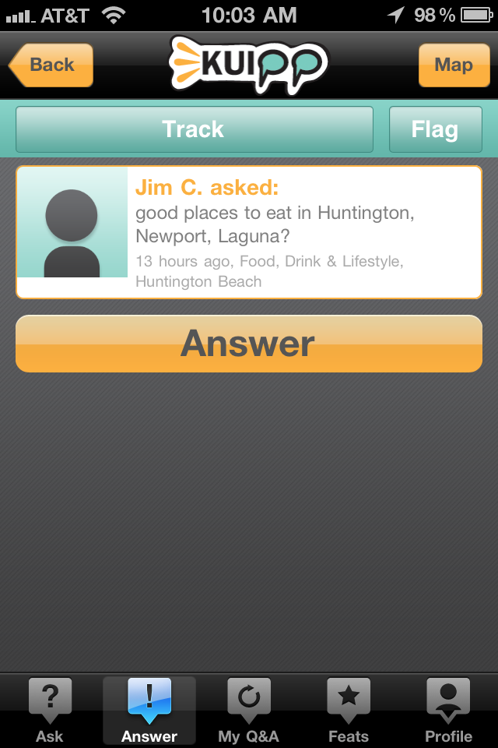


Related Questions / Information
Yelp/Foursquare: Doesn’t show the time/category information; shows the first response to the question and then in the statistics section, the # of responses are shown
Kuipp Recommended will be shown in the same modular format; this will return questions that have matched similar keywords that have been asked in the past in the similar location
Yelp Recommended
Foursquare Recommended

Slide 4

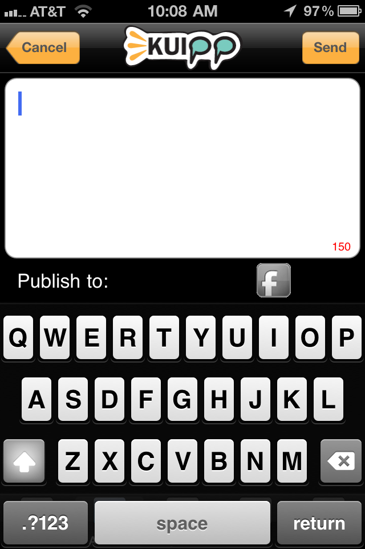
Add Twitter

Slide 5

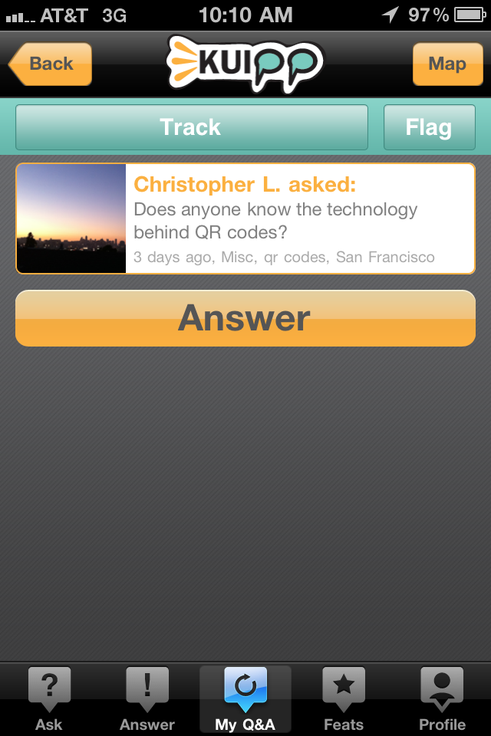
Same addition of Publish to feature to Facebook and twitter
There will be a 2 types of sharing
  Unanswered Questions (as shown): this will publish the question to FB/Twitter and ask for a response
  Question Chain’s with answers: This will publish the Question and then the highest ranked/liked answer (first answer showing on the top) to FB/Twitter (vs. showing the entire chain which would be too long anyway)

Slide 6

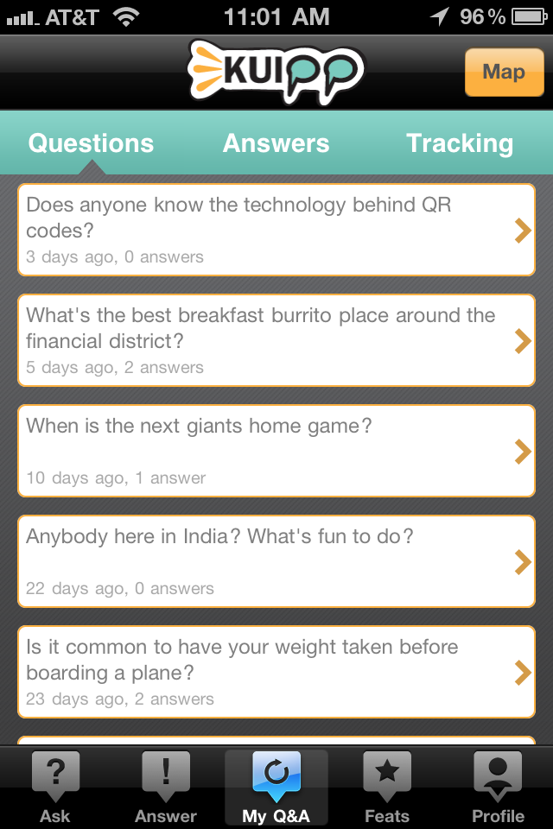
Right above the first cell module it will good to show the following statistics under the Question and Answers tabs to give a overall view of the user statistics that expands upon the profile statistics-
  # Questions (Answers)
  Top 3 categories Asked (Answered): Category 1(#), Category 2 (#), Category 3 (#)
  Average users response time to your Questions: # min
  Your average response time to other’s questions: # min

